Slide 1
Investigate Two Variables
Aggregation
Conditinal Means
Scatter Plots

Slide 2
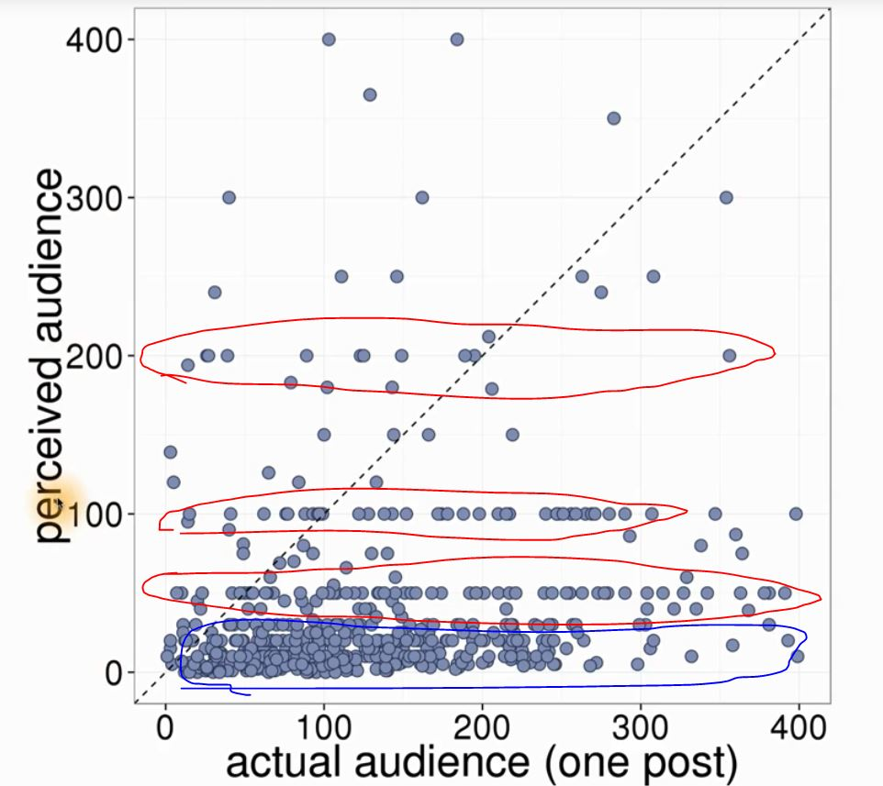
Audiance Size
Scatter Plot of «guess audiance» surwey of Moira
Red marked area are exact number guesses
Blue marked area are inaccurate guesses
Diagonal straight line is accurate line

Slide 3
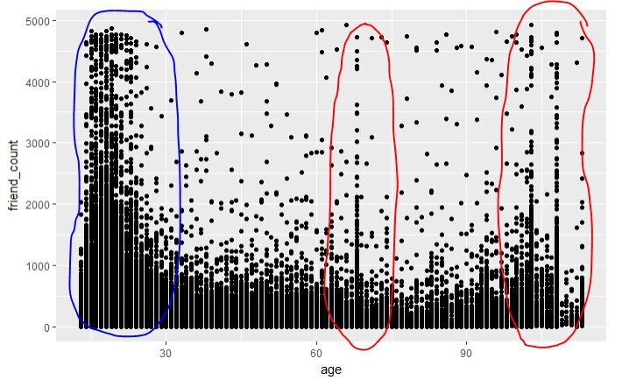
Age & Friend Count
Blue mark shows young people
Red marks show people lying about age, (fake accounts or teenagers)
pf <-read.csv(file.choose(), sep = '\t')
qplot(age, friend_count, data= pf)

Slide 4
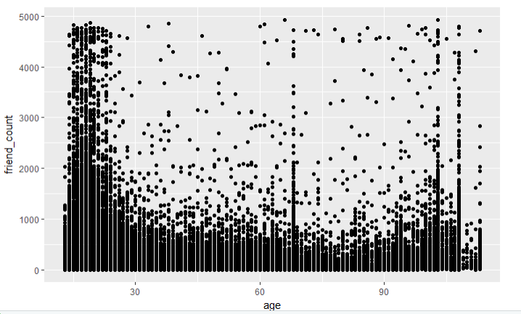
ggplot syntax
We need to add geom type
geom_point means scatter plot
aes is a static wrapper for x and y
ggplot(aes(x = age, y = friend_count),
data=pf) +
geom_point()

Slide 5
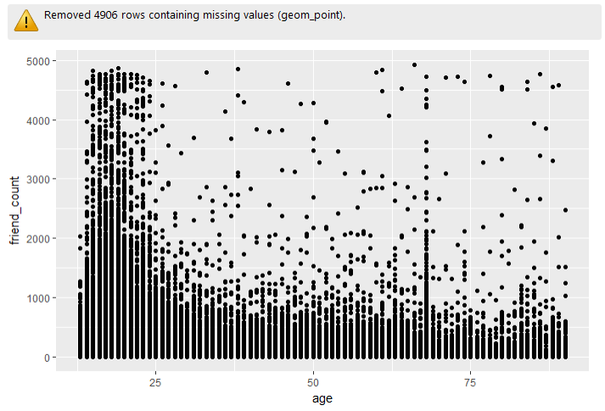
Cleaning data when plotting
xlim layer limits x axis
ggplot(aes(x = age, y = friend_count),
data=pf) +
geom_point() + xlim(13,90)

Slide 6
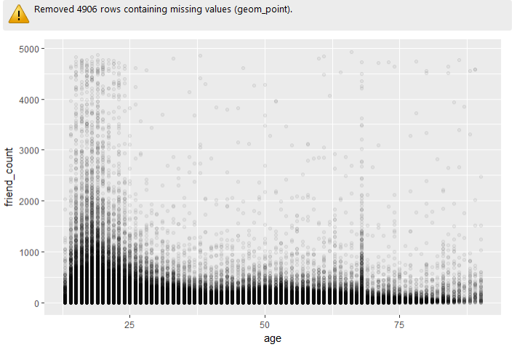
Prevent Overplotting
Alpha parameter can create better visualization
ggplot(aes(x = age, y = friend_count),
data=pf) +
geom_point(alpha=1/20) +
xlim(13,90)

Slide 7
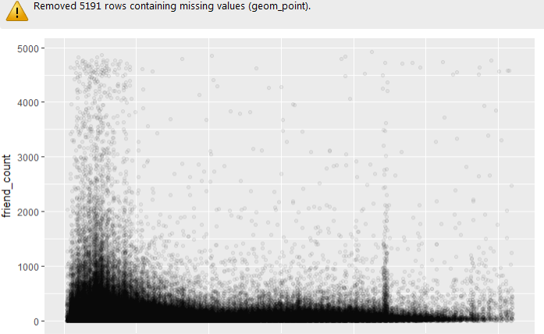
Prevent Overplotting
geom_jitter layer adds noise for better visualization
ggplot(aes(x = age, y = friend_count),
data=pf) +
geom_jitter(alpha=1/20) +
xlim(13,90)

Slide 8
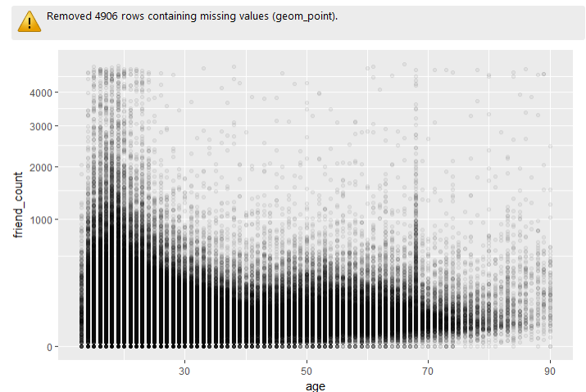
«Better visualization» in y axis
coord_trans with sqrt can be used for better visualization in y axis
ggplot(aes(x = age, y = friend_count),
data=pf) +
geom_point(alpha=1/20) +
xlim(13,90) +
coord_trans(y = 'sqrt')

Slide 9
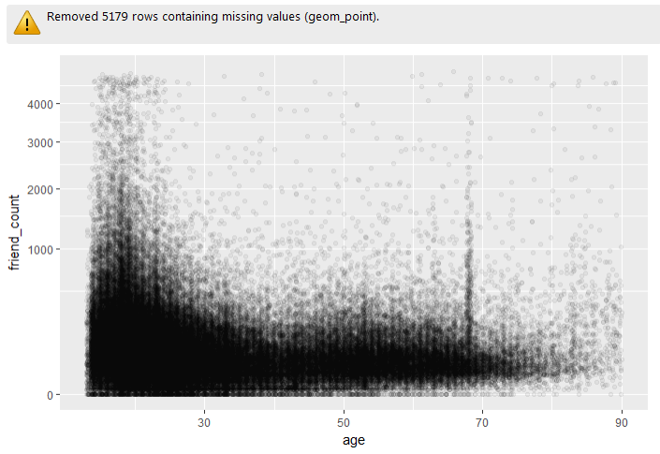
Jittering in y axis
position_jitter can create jitter in y axis
ggplot(aes(x = age, y = friend_count),
data=pf) +
geom_point(alpha=1/20,
position = position_jitter(height = 0)) +
xlim(13,90) + coord_trans(y = 'sqrt')

Slide 10
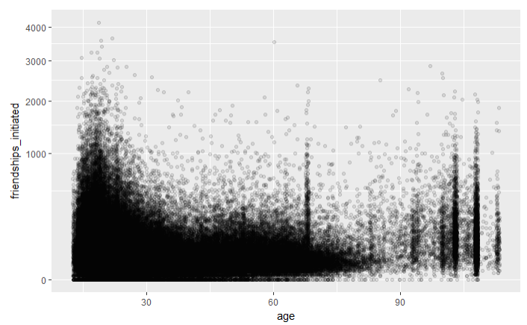
friendships_initiated
Plotting age and friendships_initiated
Visualizing with geom_jitter
Making age view better with coord_trans
To makte sqrt work, limiting h = 0
ggplot(aes(x=age, y=friendships_initiated), data=pf) +
geom_jitter(alpha = 1/10,
position = position_jitter(height = 0))+
coord_trans(y='sqrt')

Slide 11
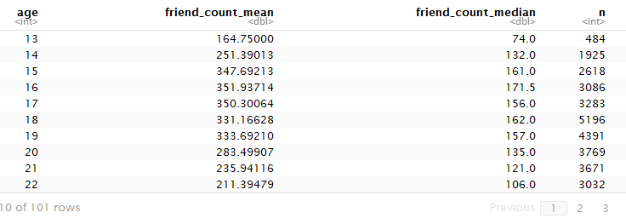
Conditional means
Friend counts by age
age_groups<- group_by(pf, age)
summarise(age_groups,
friend_count_mean=mean(friend_count),
friend_count_median=median(friend_count),
n=n())

Slide 12
Chaining functions
Chain operator %>% or %.% in old versions of dplyr
pf %>%
group_by(age) %>%
summarise(friend_count_mean=mean(friend_count),
friend_count_median=median(friend_count),
n=n())

Slide 13
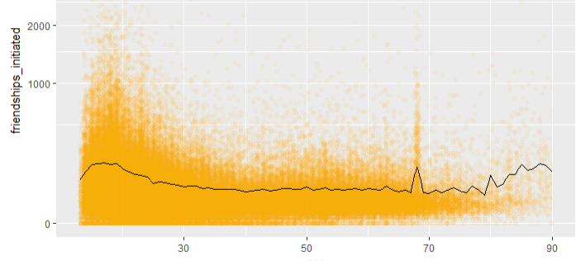
Overlaying summaries
Mean of y axis is drawn as line
ggplot(aes(x=age, y=friendships_initiated), data=pf)+
xlim(13,90)+
geom_jitter(alpha = 0.05, position = position_jitter(height = 0), color='orange')+
coord_trans(y='sqrt')+
geom_line(stat='summary', fun.y = mean)

Slide 14
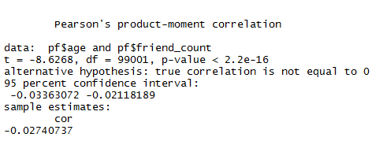
Correlation
cor.test with pearson
Other mehods are kendall and spearman
Meaningful correlation should have cor less or greater than 0.3
cor.test(pf$age, pf$friend_count, method = 'pearson')

Slide 15
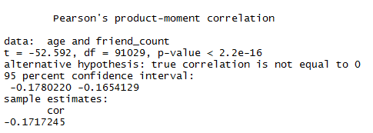
Correlation with subsets
cor.test with pearson where age <= 70
with(subset(pf, age <= 70), cor.test(age, friend_count))

Slide 16
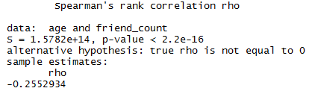
Correlation methods
with(subset(pf, age <= 70), cor.test(age, friend_count, method = 'spearman'))

Slide 17
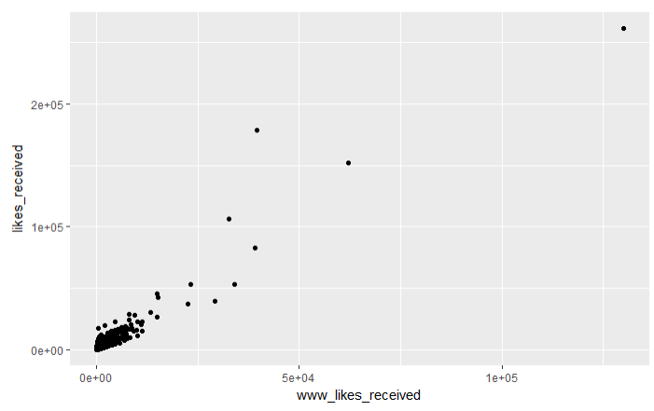
Creating scatterplots
likes_received vs www_likes_received
ggplot(aes(x = www_likes_received, y =likes_received), data=pf) +geom_point()

Slide 18
Strong correlation
likes_received vs www_likes_received
ggplot(aes(x = www_likes_received, y =likes_received), data=pf) +geom_point()

Slide 19
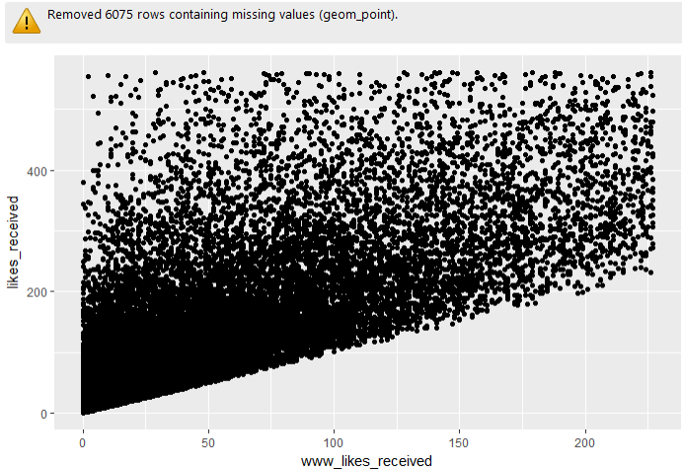
Strong correlation
likes_received vs www_likes_received (quantile 0.95 limit)
ggplot(aes(x = www_likes_received, y =likes_received), data=pf) +geom_point()+
xlim(0, quantile(pf$www_likes_received, 0.95))+
ylim(0, quantile(pf$likes_received, 0.95))

Slide 20
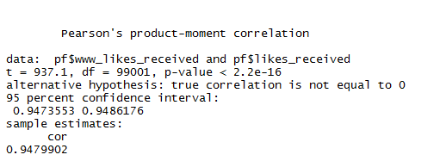
Strong correlation
Correlation of likes_received vs www_likes_received (quantile 0.95 limit)
cor.test(pf$www_likes_received,pf$likes_received)

Slide 21
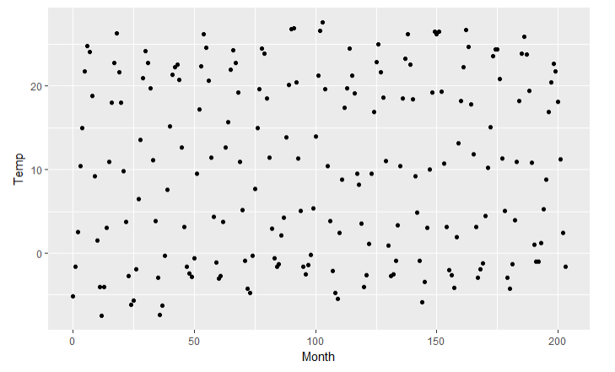
Noisy scatterplots
ggplot(data=Mitchell, aes(x =Month, y =Temp)) + geom_point()

Slide 22
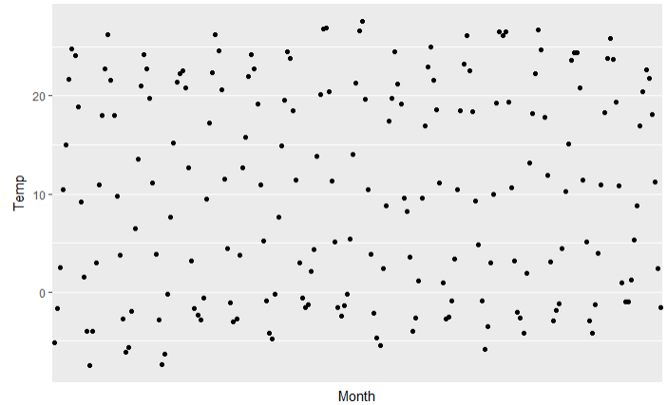
Making sense of Data
ggplot(data=Mitchell, aes(x =Month, y =Temp)) + geom_point() + scale_x_discrete(breaks = seq(0, 203, 12))

Slide 23
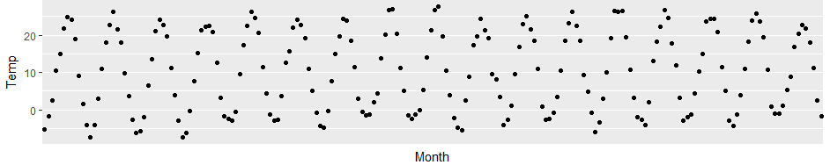
Making sense of Data
ggplot(data=Mitchell, aes(x =Month, y =Temp)) + geom_point() + scale_x_discrete(breaks = seq(0, 203, 12))

Slide 24
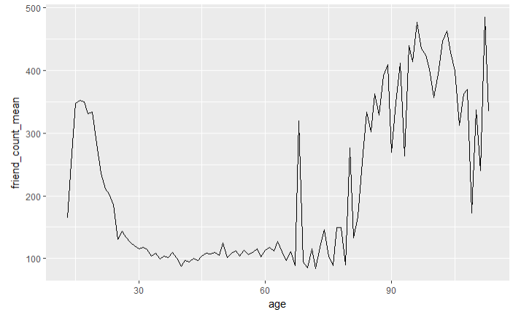
Understanding noise
ggplot(aes(x=age, y=friend_count_mean), data=pf.fc_by_age) +geom_line()

Slide 25
Understanding noise
Age with monts means
pf$age_with_months <- (pf$age * 12 + 12 - pf$dob_month) / 12
pf.fc_by_age_months <- data.frame(
pf %>%
group_by(age_with_months) %>%
summarise(friend_count_mean = mean(friend_count),
friend_count_median = median(friend_count), n = n())) %>%
arrange(age_with_months)

Slide 26
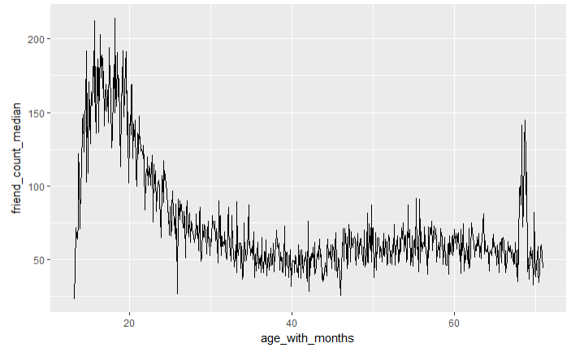
Understanding noise
Noise in conditinal means
ggplot(data = subset(pf.fc_by_age_months, age_with_months<71), aes(x=age_with_months, y=friend_count_median)) + geom_line()

Slide 27
Smoothing noise
Smoothing conditional means
p1 <-ggplot(aes(x=age, y=friend_count_mean), data=subset(pf.fc_by_age, age<71)) +geom_line()
p2 <-ggplot(aes(x=age_with_months, y=friend_count_mean), data=subset(pf.fc_by_age_months, age_with_months<71)) +geom_line()
p3 <-ggplot(aes(x=round(age/5)*5, y=friend_count), data=subset(pf, age<71)) +geom_line(stat='summary', fun.y = mean)
grid.arrange(p2, p1, p3, ncol=1)

Slide 28
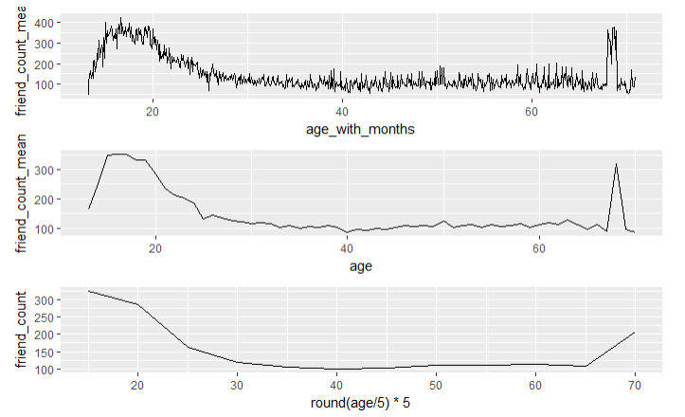
Smoothing noise
Smoothing conditional means

Slide 29
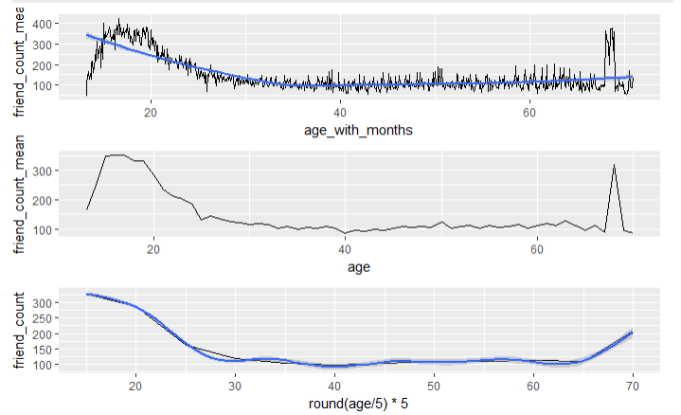
Smoothing noise
Smoothing conditional means (using +geom_smooth())

Slide 30
Which plot to choose
You don’t have to choose.
Apply multiple visualizations and summaries.
Refine your data and try again to get more insights.

Slide 31
Thank you

